Slide 1



REST vs. GraphQL vs. gRPC: Which API to Choose?
IBM iX

Slide 2



Your presenters
Daniel Strmečki
Director Digital Platforms
Solution Architect
daniel.strmecki@ibmix.hr
Dominik Lacković
Head of Digital Platforms
Technical Architect
dominik.lackovic@ibmix.hr

Slide 3

Our Agenda
Introduction
REST
  Architectural Style
  Live Demo
  Pros & Cons
GraphQL
  Architectural Style
  Live Demo
  Pros & Cons
gRPC
  Architectural Style
  Live Demo
  Pros & Cons
Which API to Choose
Mix and Match
Summary

Slide 4
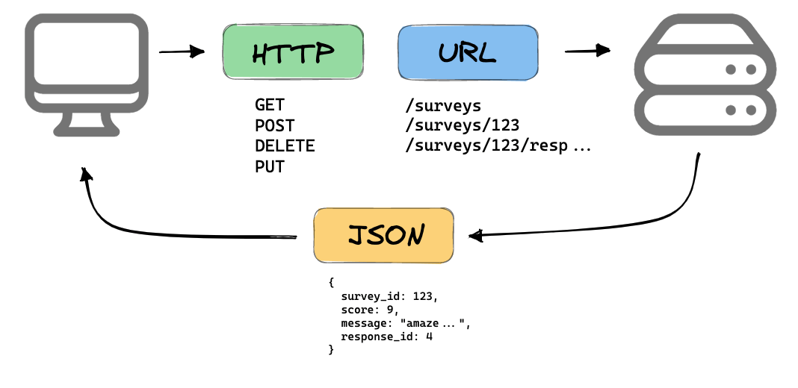
Introduction:
What do we assume as a standard for API development?
REST API
For many years an industry standard architectural style for designing web APIs
GraphQL & gRPC
Recently emerged to address some of the known limitations of REST APIs
Image taken from: https://mannhowie.com/rest-api

Slide 5

REST
Representational State Transfer
Created to guide the design and development of the architecture for the World Wide Web
The most commonly used API architectural style worldwide
Defined back in 2000 by Roy Fielding
Image taken from: https://www.cmfmag.ca/health_wellnes/the-7-types-of-rest/

Slide 6
REST:
Architectural Style
Representational State Transfer
Means that a server will respond with the representation of the requested resource (usually HTML, XML or JSON document)
That resource will contain hypermedia links that can be followed to make the state of the system change
Not a framework or a library
Architectural style describing an interface based on the URL structure and the HTTP protocol
It uses URLs to address the appropriate resources and HTTP methods to express the action to take

Slide 7
REST:
Demo time
Develop:
@GetMapping("/rest/books")
public List<Book> books() {
return booksService.getBooks();
}
Test:
this.mockMvc.perform(get("/rest/books"))
.andDo(print())
.andExpect(status().isOk())
.andExpect(content().json(expectedJson));
Run:
curl http://localhost:8082/rest/books

Slide 8
REST: Pros & Cons
Good stuff
Most mature API architectural style in the tech world so many developers are already familiar with REST and find it easy to work with
As each resource is located behind a unique URL, it is easy to monitor and rate-limit APIs
Makes caching simple by caching HTTP responses, so client and server do not need to constantly interact
Bad stuff
Not strict, so can be interpreted differently among developers
Prone to both under-fetching and over-fetching
    To fetch nested entities, we may need to make multiple requests
    Usually not usually possible to fetch only a specific piece of entity data

Slide 9

GraphQL
If you ask any Frontend developer… They will say GraphQL!
A query language for API
Including query runtime engine
Created to address over-fetching and under-fetching REST limitations
Facebook started GraphQL development in 2012 and released it as open source in 2015
Image taken from: https://tenor.com/en-GB/view/diary-of-a-wimpy-kid-charlie-wright-spice-girls-tell-me-what-you-want-gif-8481265

Slide 10
GraphQL:
Architectural Style
More than a style
Provides a query language for developing APIs with a framework for fulfilling those queries
Client-driven, as it enables its clients to define exactly what data they need for a particular use case
Data manipulation
Doesn’t rely on the HTTP methods for manipulating data and mostly uses only POST
Instead, it uses:
    Queries to request data from the server
    Mutations to modify the data on the server
    Subscriptions are to get live updates when data changes

Slide 11
GraphQL:
Demo time
Develop:
@QueryMapping
public List<Book> books() {
return booksService.getBooks();
}
Define:
Test:
type Book {
title: String!
year: Int!
author: Author! }
type Query {
books: [Book]
}
this.graphQlTester.document(document)
.execute()
.path("books")
.matchesJson(expectedJson);
Run:
curl -X POST -H "Content-Type: application/json" -d "{\"query\":\"query{books{title}}\"}" http://localhost:8082/graphql

Slide 12
GraphQL: Pros & Cons
Good stuff
Fetching and delivering only the requested data so no unnecessary data is sent over the network
More strict specification compared to the ambiguity of REST
Detailed error descriptions for debugging
Autogenerates documentation on API changes
Bad stuff
Since each query can be different, GraphQL breaks intermediate proxy caching, making caching implementations more difficult
A GraphQL query could potentially execute a large and complex server-side operation, so queries are often limited by complexity to avoid overloading the server

Slide 13

gRPC
Remote Procedural Call
A client application can directly call methods on a server application as if it was a local object
Initially created by Google in 2001 to connect their large number of microservices running across data centres
Image taken from: https://www.rimac-automobili.com/nevera/

Slide 14
gRPC:
Architectural Style
A complete framework
Contract-based strict approach where both the client and the server need access to the same schema definition
Communication via HTTP/2 using a compact binary format which makes encoding and decoding of gRPC messages very efficient
DSL called protocol buffer language defines requests and response types, while protocol buffer compiler generates the server and client code artifacts
Data manipulation
Calling method by name, like it was native
Three types of client-server interactions:
    Traditional request-response interactions
    Server streaming, where one request from the client may yield multiple responses
    Client streaming, where multiple requests from the client result in a single response

Slide 15
gRPC:
Demo time
Develop:
@Override public void books(BooksRequest request, StreamObserver<BooksResponse> responseObserver) {
List<Book> books = booksService.getBooks();
BooksResponse.Builder responseBuilder =
BooksResponse.newBuilder(); books.forEach(book ->
responseBuilder.addBook(GrpcBooksMapper.mapBookToProto(book)));
responseObserver.onNext(responseBuilder.build());
responseObserver.onCompleted();
}
Define:
message BookProto {
string title = 1;
AuthorProto author = 2;
int32 year = 3;
}
message BooksResponse {
repeated BookProto book = 1;
}
service BooksService {
rpc books(BooksRequest)
returns (BooksResponse);
}
Test:
List<Book> books = response.getBookList().stream()
.map(GrpcBooksMapper::mapProtoToBook)
.collect(Collectors.toList()); JSONAssert.assertEquals(objectMapper.writeValueAsString(books), expectedJson, true);
Run:
grpcurl --plaintext localhost:9090 com.baeldung.chooseapi.BooksService/books

Slide 16
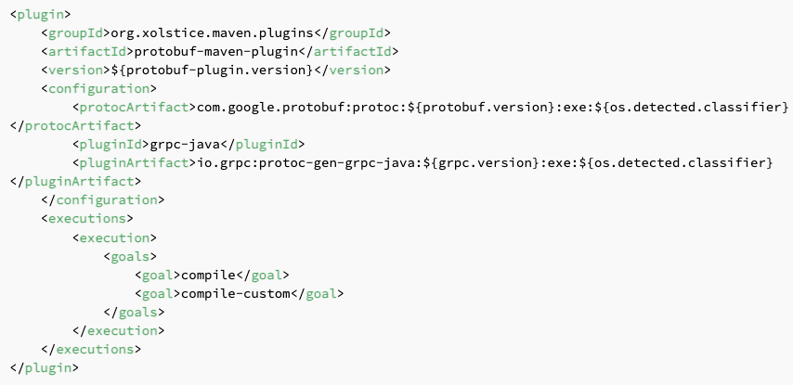
Note on Protocol Buffer Compiler
Start by defining a schema that defines the service, requests, and responses including their fields and types.
Then, the protocol buffer compiler needs to generate the required code.
We can make it a part of the build process using the protobuf-maven-plugin.
IBM iX / © IBM Corporation

Slide 17
gRPC: Pros & Cons
Good stuff
Great performance, enabled by a compact data format and fast message encoding/decoding
Requiring HTTP/2 and TLS/SSL provides better security defaults and built-in support for streaming
Bad stuff
Longer learning curve and is much less popular compared to REST in the developer community
Data format unreadable for humans, so additional tools are required to analyse payloads and perform debugging
HTTP/2 is only supported via TLS in the recent versions of modern browsers

Slide 18
Which API to Choose for your next project?
It depends ☺

Slide 19
Which API to Choose?
Things to Consider 1/2
Data Format
REST is the most flexible approach in terms of request and response data formats
GraphQL defines its own query language that needs to be used when requesting data and usually responding in JSON format
The gRPC framework requires a custom binary format
Data Fetch
GraphQL is the most efficient API approach for fetching data from the server as it allows clients to select which data to fetch, there is usually no extra data sent over the network
Both REST and gRPC do not support such advanced client querying
Browser Support
REST and GraphQL are supported in all modern browsers
Browser support doesn’t come out of the box for gRPC, but an extension for the web is available, however based on HTTP/1

Slide 20
Which API to Choose?
Things to Consider 2/2
Library Support
REST uses no predefined schema and does not require code generation or any libraries besides HTTP
Both GraphQL and gRPC require additional libraries to be added to a core framework like Spring
gRPC also requires a mandatory code generation step, while code generation from a GraphQL schema is possible but not required
Response Time
Thanks to its optimized binary format, gRPC has significantly faster response times compared to REST and GraphQL
Load balancing can be used in all three approaches to evenly distribute client requests across multiple servers
Caching
Caching requests and responses on the HTTP level with REST is simple and mature
With GraphQL each query can be different, which makes caching implementation difficult (e.g. persisted queries)
Caching requests and responses is not supported in gRPC by default

Slide 21
Intended Usage
REST
Good fit for domains that can be easily described as a set of resources. By relying on HTTP semantics, it’s intuitive to its callers, making it a good fit for public-facing interfaces. Good caching support for REST makes it suitable for APIs with stable usage patterns and geographically distributed users.
GraphQL
Good fit for public APIs where multiple clients require different data sets. GraphQL clients can specify the exact data they want through a standardized query language. This makes GraphQL also a good choice for APIs that aggregate data from multiple sources and then serve it to multiple clients.
gRPC
Good fit when developing internal microservices that require high performance and have frequent interaction between them. Commonly used for collecting data from low-level agents like different IoT devices. However, its limited browser support makes it difficult to use in customer-facing web applications.

Slide 22
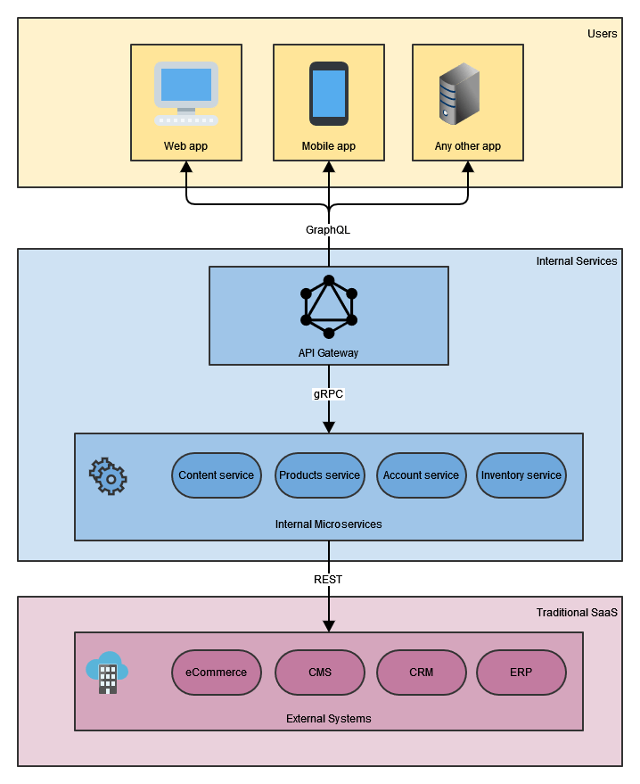
Each of the three API architectural styles has its benefits.
However, there’s no one-size-fits-all approach, and which approach we choose will depend on our use case.
We don’t have to make a single choice every time.
We can also mix and match different styles in our solution architecture.
Different API styles can be applied in different application layers where it makes sense.
Mix & Match

Slide 23
Summary
We explored three popular architectural styles for designing web APIs: REST, GraphQL, and gRPC.
We looked at each different style use cases and described its benefits and trade-offs.
We explored how to build a simple service using all three different approaches in Spring Boot.
Then, we compared them by looking at several criteria that should be considered before deciding on an approach.
Finally, as there’s no one-size-fits-all approach, we saw how we could mix and match different approaches in different application layers.

Slide 24
That’s all from us!
Questions?
You can find the complete article on Baeldung: https://www.baeldung.com/rest-vs-graphql-vs-grpc
Including code examples on GitHub:
https://github.com/eugenp/tutorials/tree/master/spring-boot-modules/spring-boot-graphql/src/main/java/com/baeldung/chooseapi

