Slide 1
Microservice development in Kotlin
Pros and cons of using Ktor
Ivan Sokol

Slide 2
Agenda
01 Intro
Why, Kotlin, Ktor
02 Build
Gradle, Plugins, BOM
03 Core
Koin, Configuration, Validation, Security
04 Communication
Ktor server, Ktor client, Komapper, Zeebe
05 Testing
Kotest, Mocks, Spotless, Kover
06 Operations
OpenTelemetry, HTTP Log Filter, Cohort
07 CI/CD
Gitlab, Pipelines, Vault
08 Pros/Cons

Slide 3
Intro
Why?
Java
Reactive Spring
Issues
Lightweight
Context bounded
JSON
REST
SQL
Extensible
Kotlin
https://kotlinlang.org/
JVM
statically typed
concise
versatile
interoperable
expressive
safe
efficient
functional
Ktor
https://ktor.io/
web micro-framework
lightweight
asynchronous
couroutine based
modular
extensible

Slide 4
Build
Gradle
Kotlin format
Public plugins:
Properties - https://github.com/stevesaliman/gradle-properties-plugin
Git - https://github.com/palantir/gradle-git-version
Formatting - https://github.com/diffplug/spotless
Code coverage - https://github.com/Kotlin/kotlinx-kover
Cobertura coverage report - https://github.com/razvn/jacoco-to-cobertura-gradle-plugin
Custom made plugin – dependency resolution, jvm, test, jar, publishing
BOM for public dependencies

Slide 5
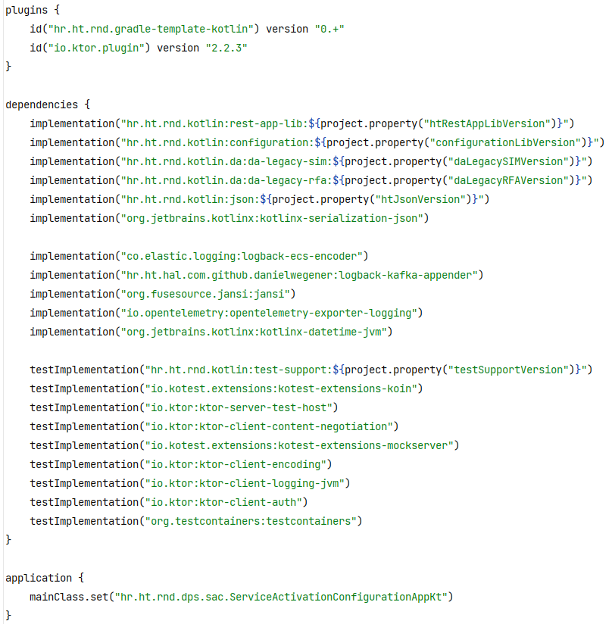
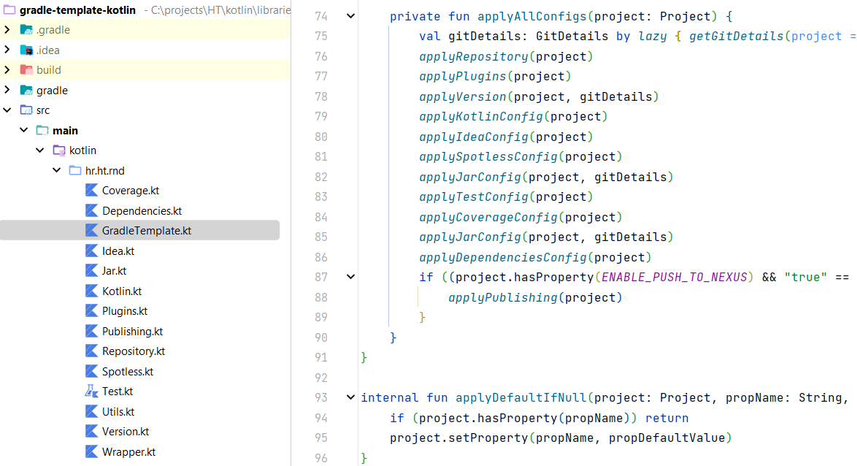
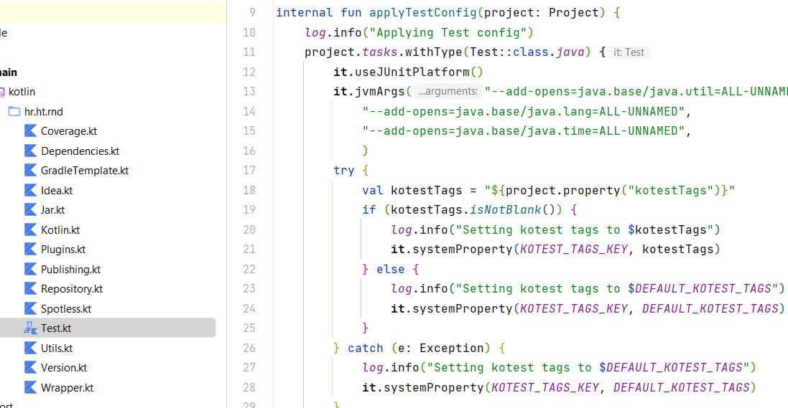
Build

Slide 6
Core
Dependency injection
Koin - https://insert-koin.io/
Singletons
Modules
Configuration
Lightbend config - https://github.com/lightbend/config
Profiles, Sys properties, Environment vars
Secrets
Validation
Valiktor - https://github.com/valiktor/valiktor
Security
JWT
Server – modified Ktor lib
Client – Ktor client lib

Slide 7
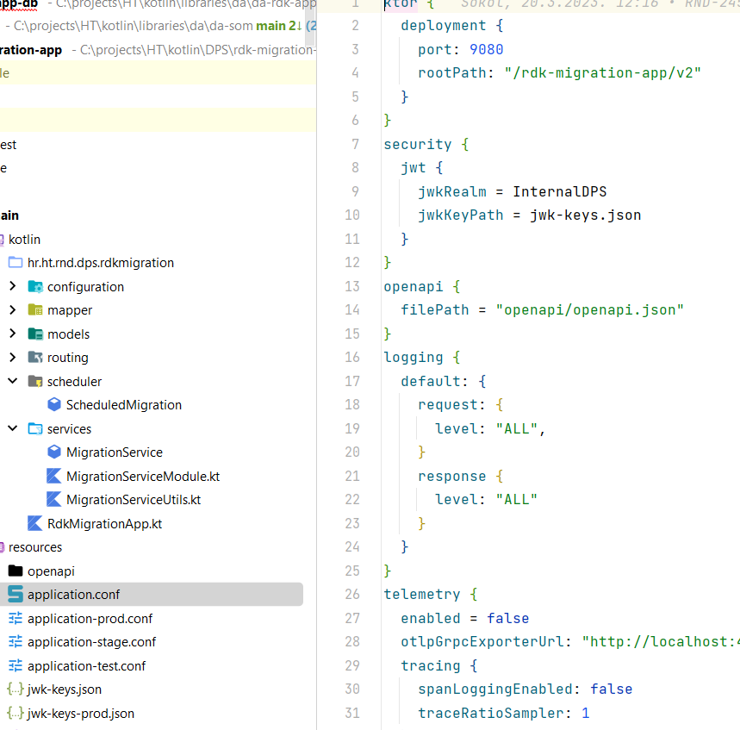
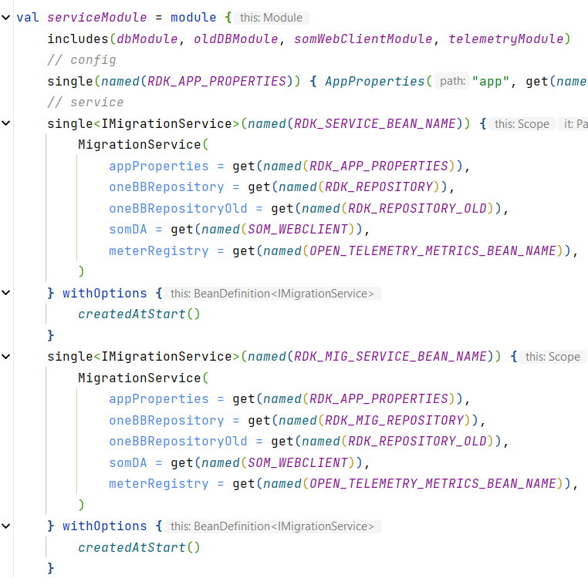
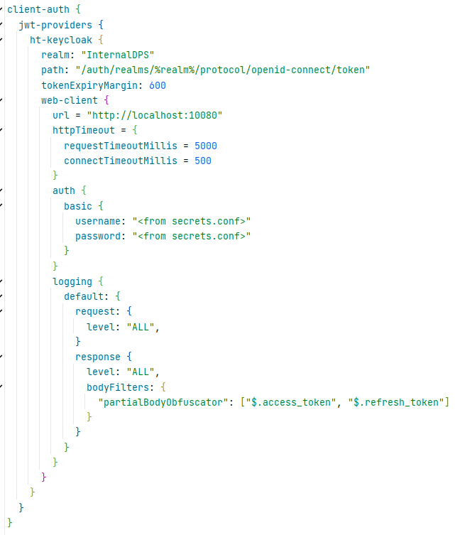
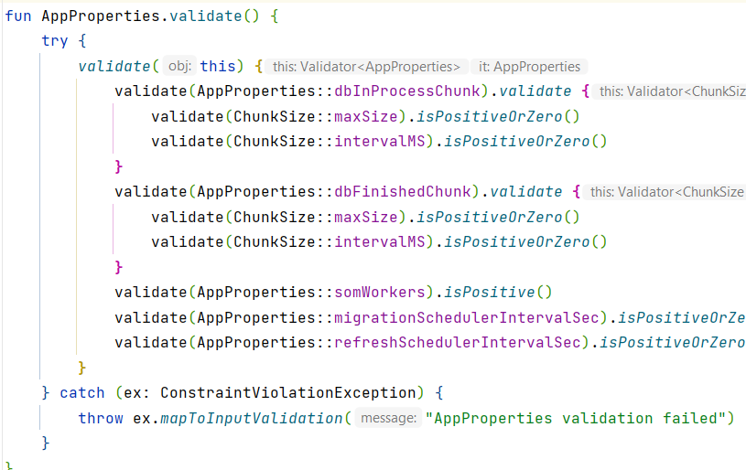
Core

Slide 8
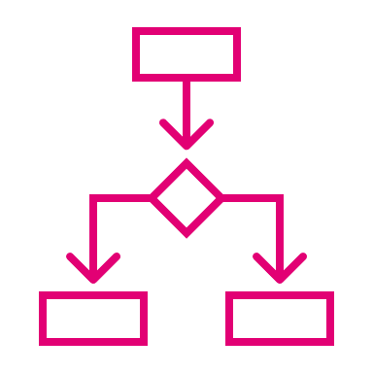
Communication
HTTP Server
Ktor server - https://ktor.io/docs/welcome.html
CIO
ContentNegotiation, StatusPages, Authentication (JWT), SwaggerUI, DoubleReceive
HTTP client
Ktor client - https://ktor.io/docs/welcome.html
CIO
Authentication (JWT/Basic/Token), Proxy, SSL, ContentNegotiation, Timeouts
SQL
Komapper - https://www.komapper.org/docs/
Oracle, Postgres
JDBC, QueryDSL
BPMN
Zeebe - https://github.com/camunda/zeebe
Kotlin Coworker - https://github.com/camunda-community-hub/kotlin-coworker

Slide 9
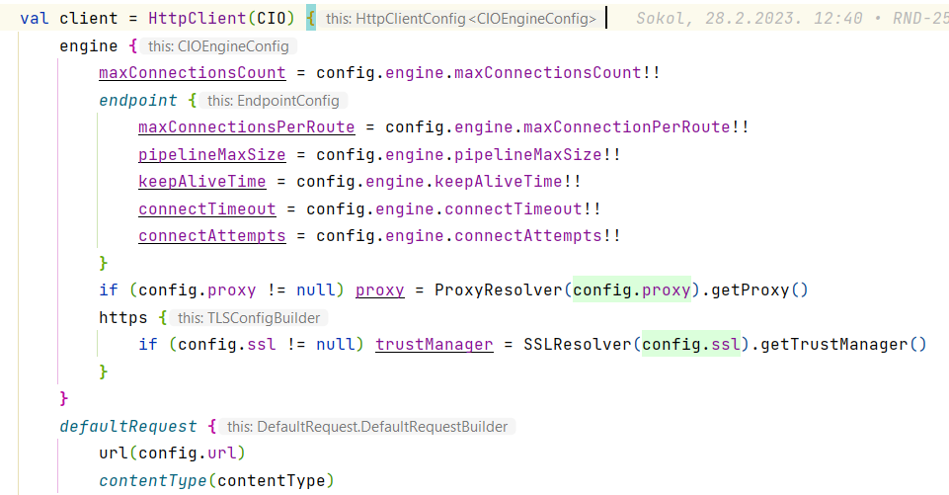
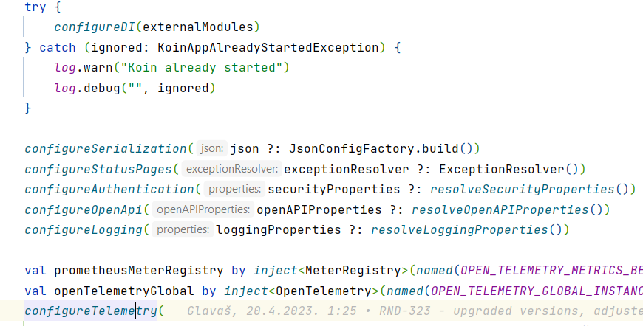
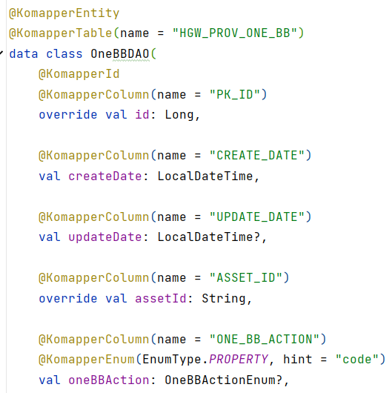
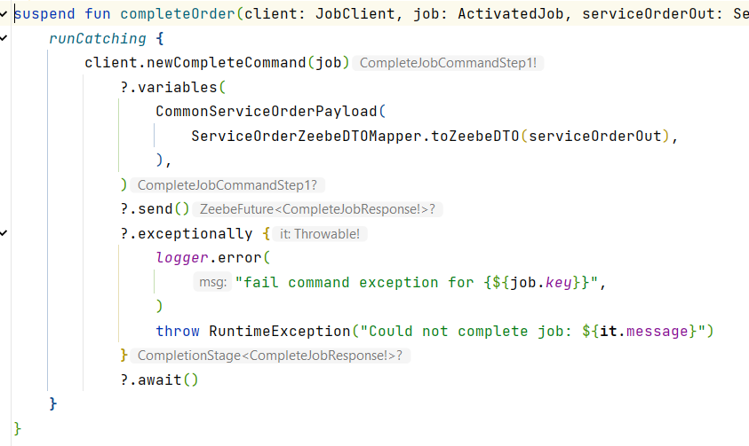
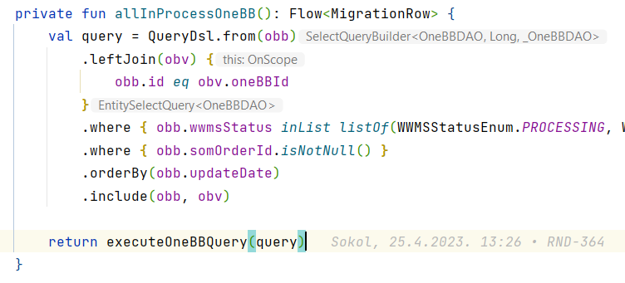
Communication

Slide 10
Testing
Testing library
Kotest - https://kotest.io/
Tests, Assertions (JSON)
Multiple testing styles
Extensions – Ktor, System, MockServer, Testcontainers, Koin
Mocking
Mockk - https://mockk.io/
Testcontainers - https://www.testcontainers.org/
MockServer - https://www.mock-server.com/
Code formatter
Spotless - https://github.com/diffplug/spotless
Kotlin, Gradle
Code coverage
Idea engine, export to Cobertura report (GitLab CI)
Kover - https://github.com/Kotlin/kotlinx-kover

Slide 11
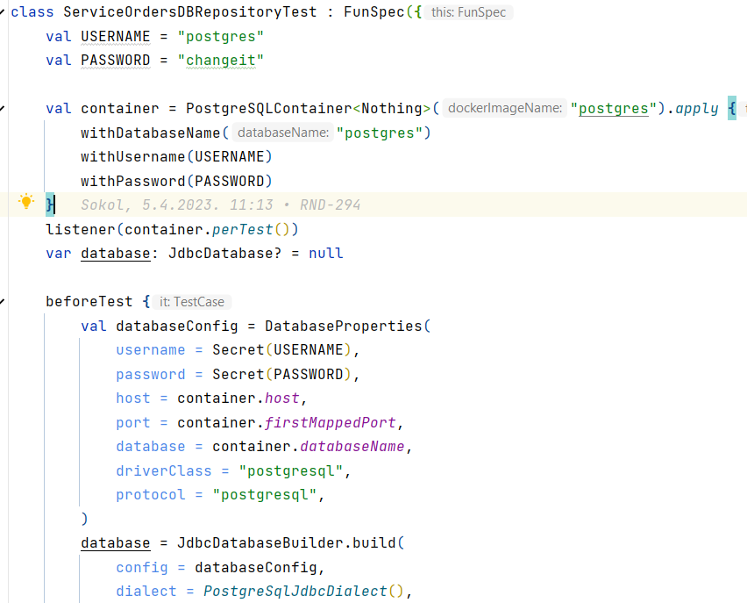
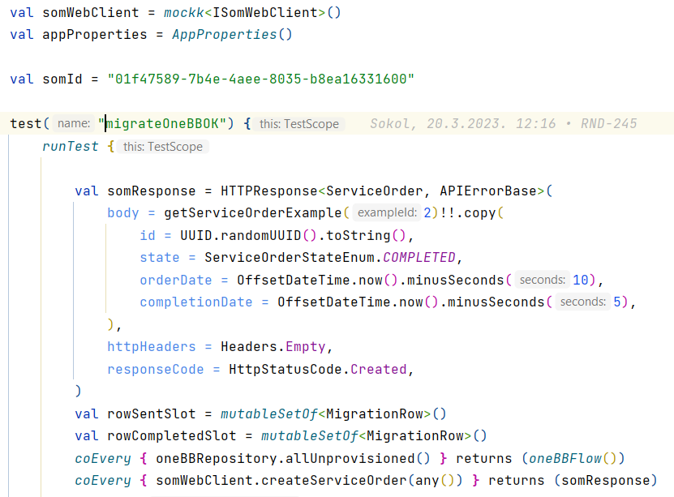
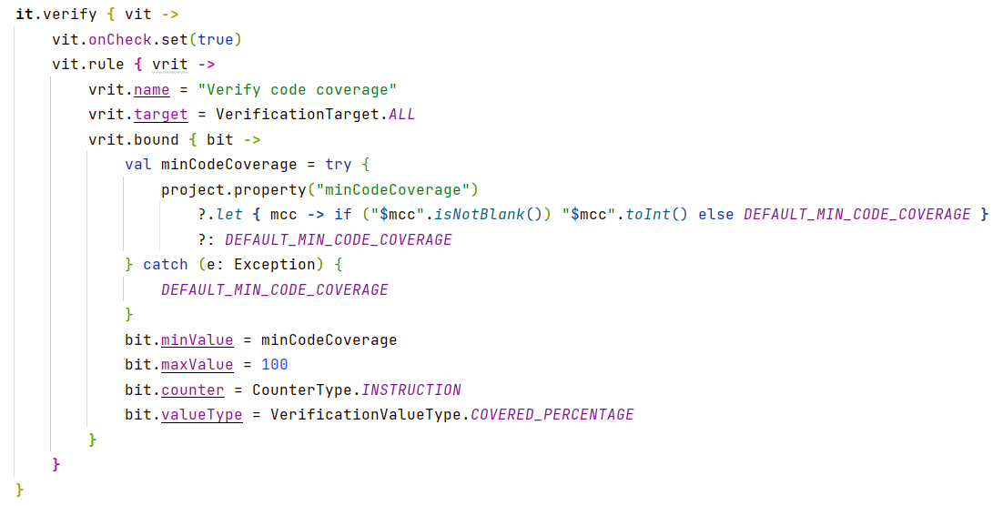
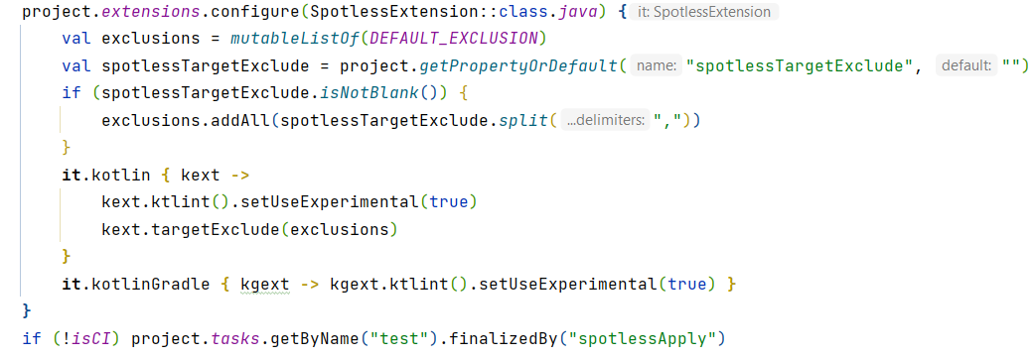
Testing

Slide 12
Operations
Observability
OpenTelemetry -https://opentelemetry.io/
Java agent - https://github.com/open-telemetry/opentelemetry-java-instrumentation
Tracing/Metrics
Logs
Ktor Server/Client plugin
ECS formatter - https://www.elastic.co/guide/en/ecs/current/index.html
Otel Collector - https://opentelemetry.io/docs/collector/
HTTP Log Filter
Custom made
Ktor Server/Client plugin
Partial/full redaction
Configurable
Management
Cohort - https://github.com/sksamuel/cohort
Liveness, Readiness
Logging config

Slide 13
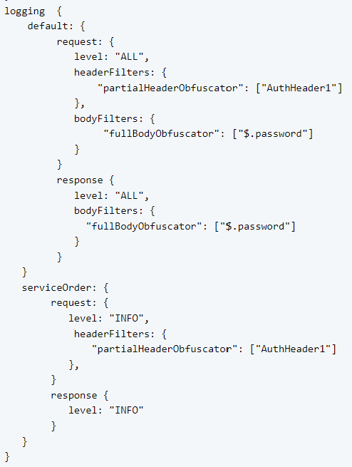
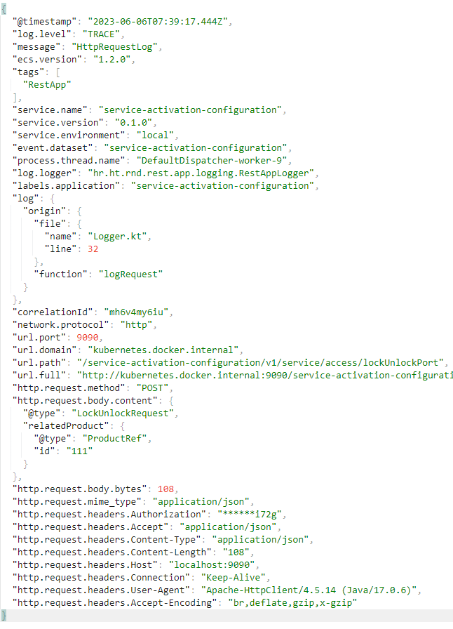
Operations

Slide 14
CI/CD
GitLab CI
Docs - https://docs.gitlab.com/ee/ci/
.gitlab-ci.yml
Triggers
Shared variables, secrets
Docker runner
Pipelines
Main, feature/*, release/*, bugfix/*
Decoupled CI and CD
Artifacts
Releases
Templates:
Libs
Apps
Microservices
Deployment project
Config
Image
Vault
Hashicorp Vault - https://www.vaultproject.io/
Secrets, Logback
Helm charts

Slide 15
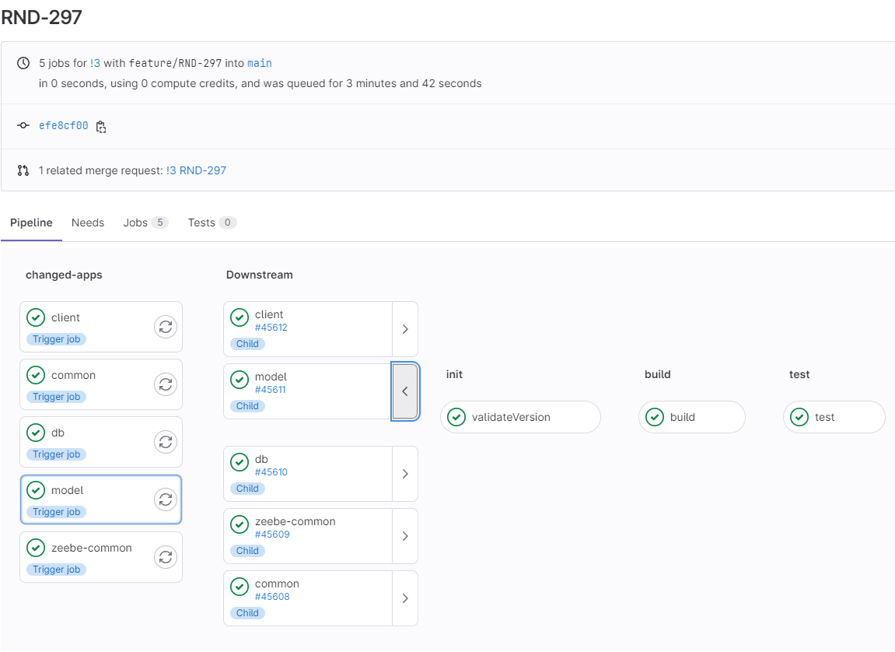
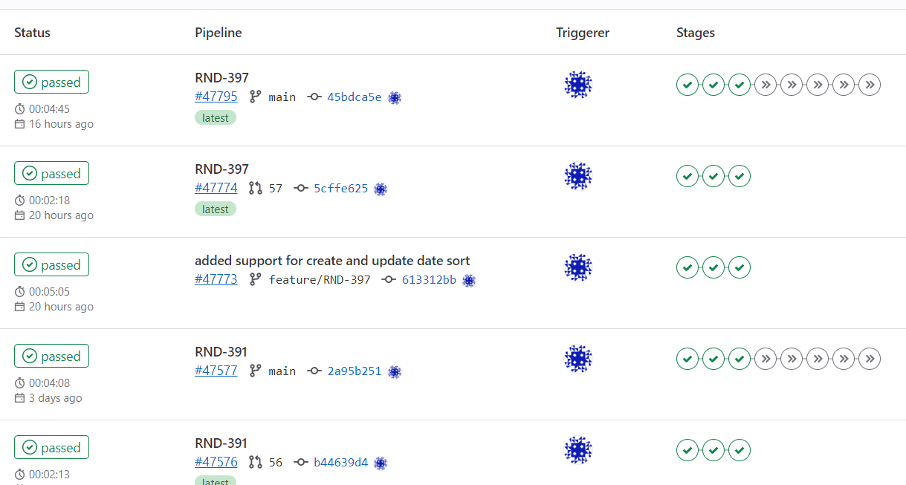
CI/CD

Slide 16
Pros/Cons
Pros
Simpler
Learning curve
Effective
Lightweight (up to 40% smaller memory consumption)
No autoconfiguration
Cons
Documentation maturity
Smaller ecosystem
Core team design decisions
Similar
Startup time
Capabilities
Performance

