Slide 1



Reactive Systems With Webflux
Adnan Isajbegović

Slide 2
Intro
Why reactive
When to be reactive
Manifesto
Java libraries
Spring Webflux
Code examples

Slide 3

Why reactive?
Increase in requests
Large and/or long lasting requests/responses
Thread number spikes
Exploding failures
Handle network issues

Slide 4
When to be reactive?
100+ requests per minute
Requests require 5+ seconds
High thread usage

Slide 5
What to expect
Takes time to adopt
Behaves serveral times better than blocking application
Less resource consumption
More resilient applications
New reactive libraries comes out regularly
Not that much public APIs supports Reactive communications

Slide 6
Reactive manifesto
Defined what reactive means
  Highly responsive
    Under large number of requests
    Under networking issues
    Under long processing
  Tolerant to failure
    Exception handling
    Don‘t break everything
  Elastic in a cost-effective way
  Message driven
https://reactivemanifesto.org/

Slide 7
Reactive Streams Specification
Java 8+
Reactive stream interfaces:
  Publisher
  Subscriber
  Subscription
  Processor
Java 9 Flow
https://github.com/reactive-streams/reactive-streams-jvm

Slide 8
Project reactor
Based on Reactive Stream Specification
Flux and Mono
<dependency>
<groupId>io.projectreactor</groupId>
<artifactId>reactor-core</artifactId>
</dependency>

Slide 9
Mono
Mono.just(user)
.map(user -> user.getEmail())
.subscribe(System.out::println);

Slide 10
Mono
reactiveCassandraRepository
.getByid(id)
.subscribe(System.out::println);

Slide 11
Flux
Mono<List<user>> users =
Flux.using(()
-> Files.lines(path),
Flux::fromStream,
BaseStream::close)
.flatMap(e -> Mono.fromCallable(() ->
mapper.readValue(e, User.class)))
.collectList();

Slide 12
Flux
Flux.generate(sink -> sink.next(getNextValue())
.delayElements(Duration.ofSeconds(1))
.subscribe(System.out::println);

Slide 13
Webflux
Since Spring 5
Coexist with Spring MVC

Slide 14
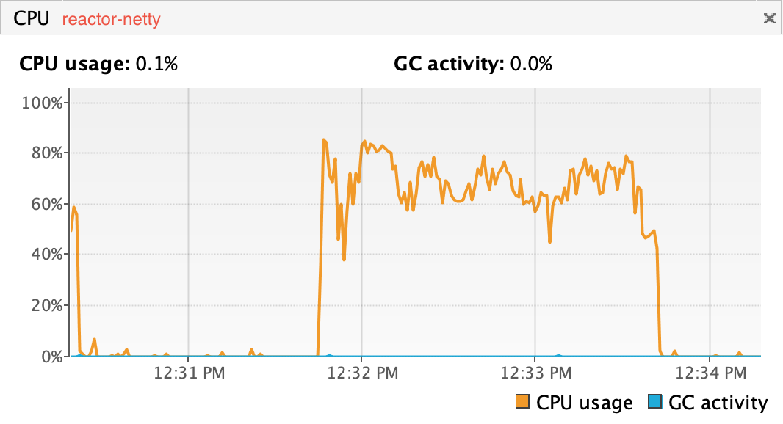
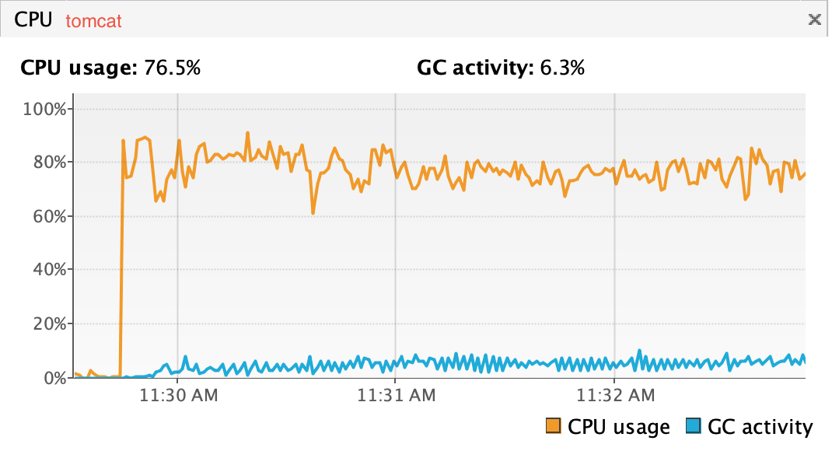
Netty
NIO
Event-driven

Slide 15
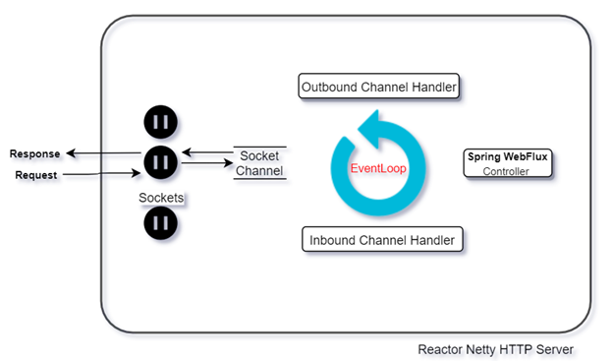
Netty
NIO
Event-driven

Slide 16
Webflux
// brings in reactor core and reactor netty
<dependency>
<groupId>org.springframework.boot</groupId>
<artifactId>spring-boot-starter-webflux</artifactId>
</dependency>

Slide 17
RestController
@RestController
public class UserController {
  @GetMapping("/get/{id}")
  public Mono<User> getById(@PathVariable(value = "id") String id) {
  return userService.getById(id);
  }
}

Slide 18
Routing
@Bean
public RouterFunction<ServerResponse> userRouter() {
return route(GET(USER_PATH).and(accept(APPLICATION_NDJSON)), userHandler::getById)
.andRoute(POST(USER_PATH).and(accept(APPLICATION_NDJSON)), userHandler::save)
.andRoute(DELETE(USER_PATH).and(accept(APPLICATION_NDJSON)), userHandler::delete);
}

Slide 19
WebClient
@Bean
public WebClient mapsLocationWebClient() {
return webClientBuilder
.baseUrl(mapsLocationProperties.getUrl())
.defaultHeaders(header -> {
header.add(HttpHeaders.CONTENT_TYPE, MediaType.APPLICATION_NDJSON_VALUE);
})
.build();
}
}

Slide 20
WebClient
mapsLocationClientBuilder
.get()
.uri(uri -> uri.path("/place/{id}").build(id))
.retrieve()
.bodyToMono(Place.class);

Slide 21
Webflux Security
<dependency>
<groupId>org.springframework.boot</groupId>
<artifactId>spring-boot-starter-security</artifactId>
</dependency>

Slide 22
Webflux Security
@EnableWebFluxSecurity
public class WebfluxSecurityConfig {
@Bean
public MapReactiveUserDetailsService userDetailsService() {
UserDetails user = User.withDefaultPasswordEncoder()
.username("user")
.password("user")
.roles("USER")
.build();
return new MapReactiveUserDetailsService(user);
}
}

Slide 23
OpenApi
<dependency>
<groupId>org.openapitools</groupId>
<artifactId>openapi-generator-maven-plugin</artifactId>
<version>${openapi-generator.version}</version>
</dependency>
<dependency>
<groupId>org.springdoc</groupId>
<artifactId>springdoc-openapi-webflux-ui</artifactId>
<version>>${openapi.version}</version>
</dependency>

Slide 24
Code example
https://github.com/adnanisajbeg/java-cro-reactive-service

